Slide 1
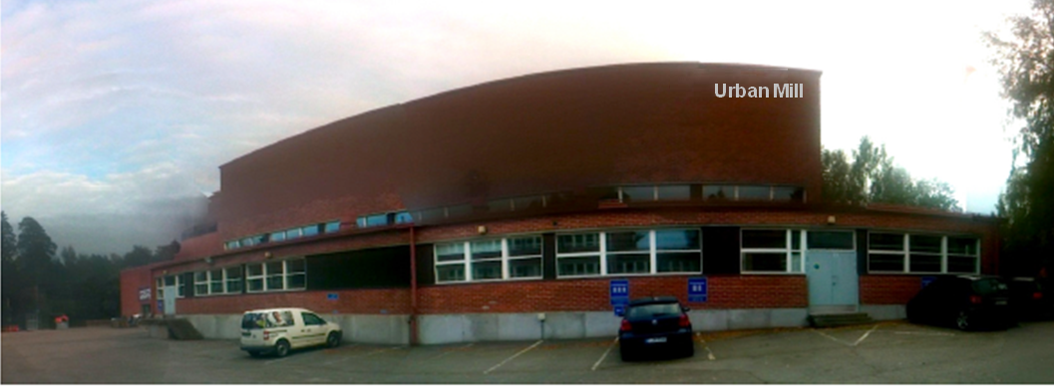
Urban Mill – yritysten, tutkijoiden ja kaupunkien kohtaamis- ja työtila!
Versio 4.24 (6.2.2013)
Yhdessätekemistä yli rajojen
Urban
Mill
Energizing Urban Ecosystems Research Program 2012-2015, WP Regional Innovation Ecosystem (RIE)
Task 7: T3 Ba & Flow, Aalto-yliopistokiinteistöt Oy & Järvelin Design Oy, Kari Mikkelä & Lars Miikki 31.12.2012

Slide 2
Background of the Urban Mill development: Research Focus according the EUE programme plan
The focus of the research is to define which spatial and operational solutions the entire T3 area requires in order to become the world-leading innovation platform and to create a grounded concept description of how to accomplish this. Task 7 co-operates closely with Tasks 4, 5 and 6, and also with the WP SIC, and utilizes their results.
The first output of this Task is developing an Energizing Urban Ecosystems Hub with a common workspace – a physical, mental and virtual space – for the entire EUE program. Järvelin Design Oy’s team, coordinated by Lars Miikki, will create an overall model combining theory and practice, (illustrated with case examples) in 2012, integrating the necessary actors required for the research during 2013-2015.
During 2013-2015 this Task will conduct research focused on real life practice involving co-creation methods and tools, as well as multi-sense based spaces for maintaining the energy level and supporting these activities. This conceptualizes the content and events into a coherent whole that systemically connects to society and will have a strong societal impact recognized through mind-set changes in the T3 area.
Energizing Urban Ecosystems Research Program 2012-2015, WP Regional Innovation Ecosystem (RIE)
Task 7: T3 Ba & Flow, Aalto-yliopistokiinteistöt Oy & Järvelin Design Oy, Kari Mikkelä & Lars Miikki 16.1.2013

Slide 3
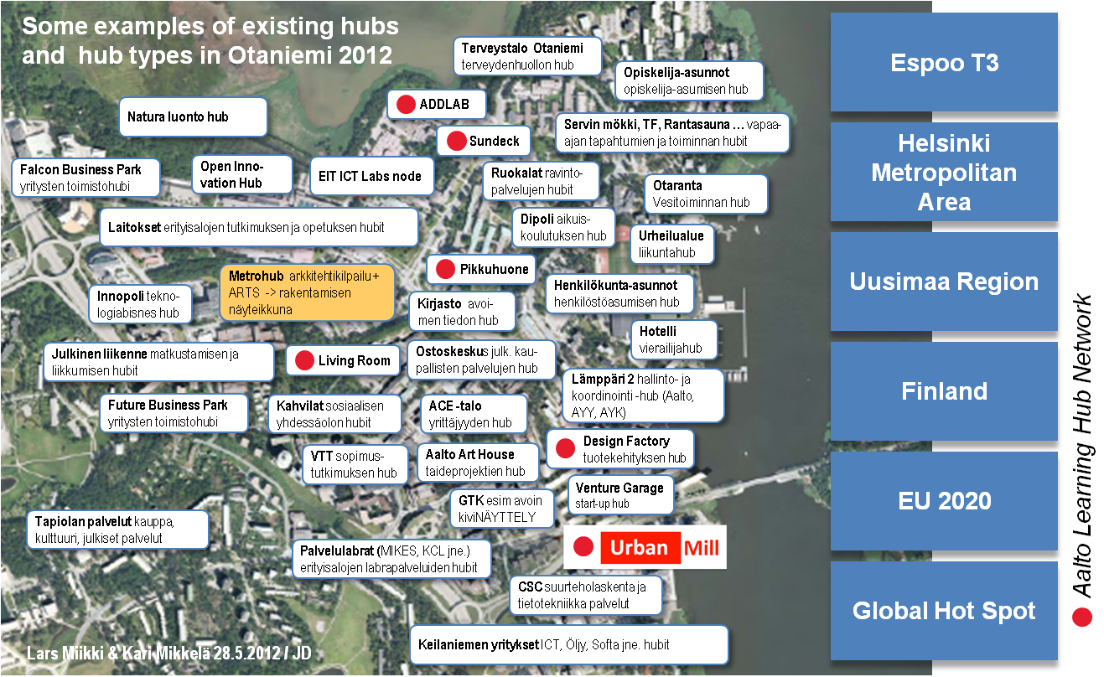
Urban Mill as a Development Hub for Otaniemi Thematic Co-working Space Network Service Development
Energizing Urban Ecosystems Research Program 2012-2015, WP Regional Innovation Ecosystem (RIE)
Task 7: T3 Ba & Flow, Aalto-yliopistokiinteistöt Oy & Järvelin Design Oy, Kari Mikkelä & Lars Miikki 16.1.2013

Slide 4
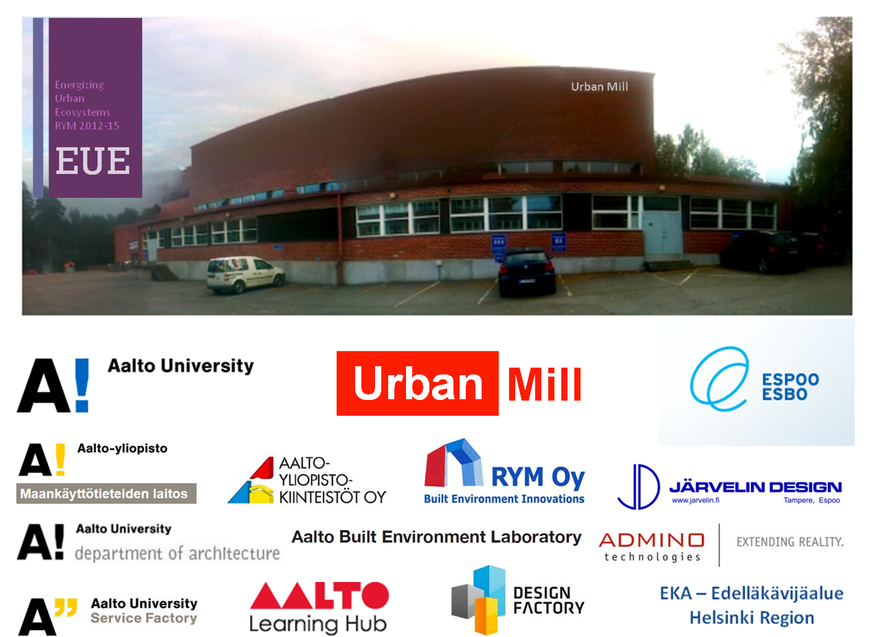

Slide 5
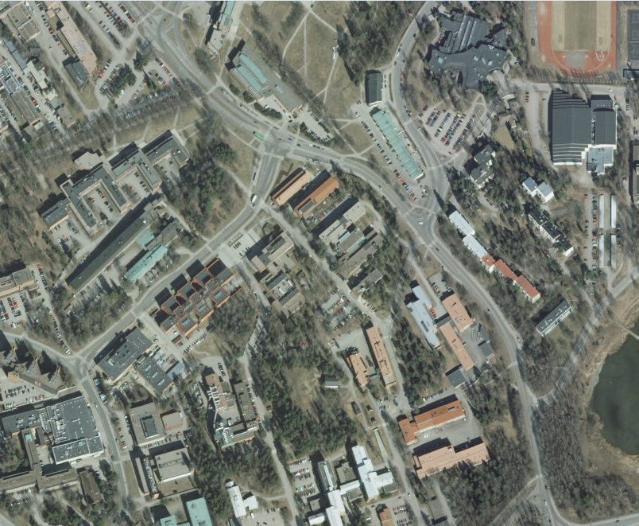



Urban Mill & Design Factory & Start Up Sauna
as joint platform for Knowledge Triangle activities
Ilmakuva: Karttapaikka. Maanmittauslaitos 15.1.2013
Energizing Urban Ecosystems Research Program 2012-2015, WP Regional Innovation Ecosystem (RIE)
Task 7: T3 Ba & Flow, Aalto-yliopistokiinteistöt Oy & Järvelin Design Oy, Lars Miikki & Kari Mikkelä 16.1.2013

Slide 6
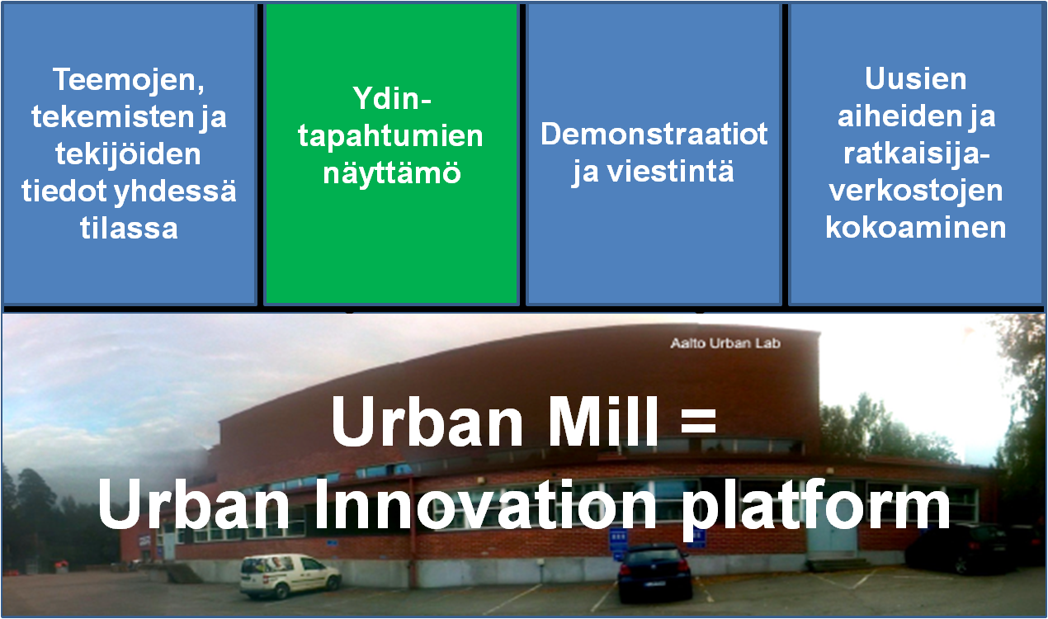
Urban Mill – Urbaanien innovaatioiden keskiö
Energizing Urban Ecosystems Research Program 2012-2015, WP Regional Innovation Ecosystem (RIE)
Task 7: T3 Ba & Flow, Aalto-yliopistokiinteistöt Oy & Järvelin Design Oy, Kari Mikkelä & Lars Miikki 16.1.2013

Slide 7
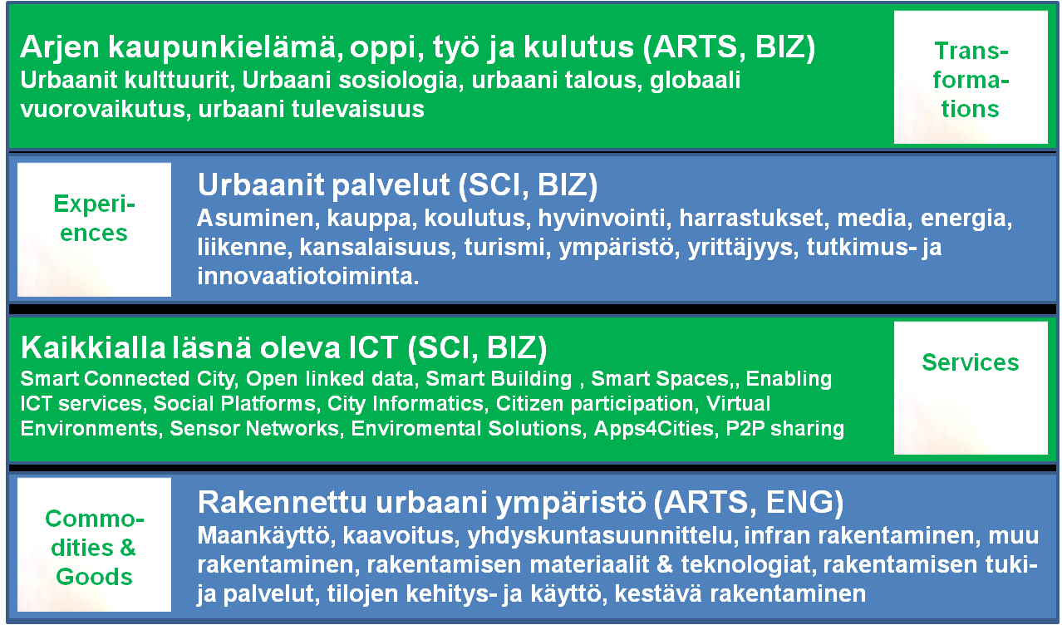
Urban Mill Research Domains & Global Networks
Energizing Urban Ecosystems Research Program 2012-2015, WP Regional Innovation Ecosystem (RIE)
Task 7: T3 Ba & Flow, Aalto-yliopistokiinteistöt Oy & Järvelin Design Oy, Kari Mikkelä & Lars Miikki 16.1.2013

Slide 8
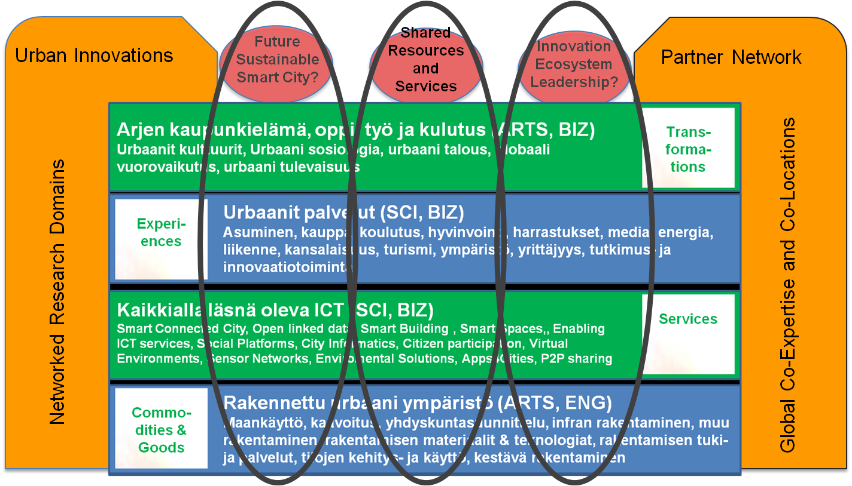
Urban Innovation Themes vs. Research Domains
Energizing Urban Ecosystems Research Program 2012-2015, WP Regional Innovation Ecosystem (RIE)
Task 7: T3 Ba & Flow, Aalto-yliopistokiinteistöt Oy & Järvelin Design Oy, Kari Mikkelä & Lars Miikki 16.1.2013

Slide 9
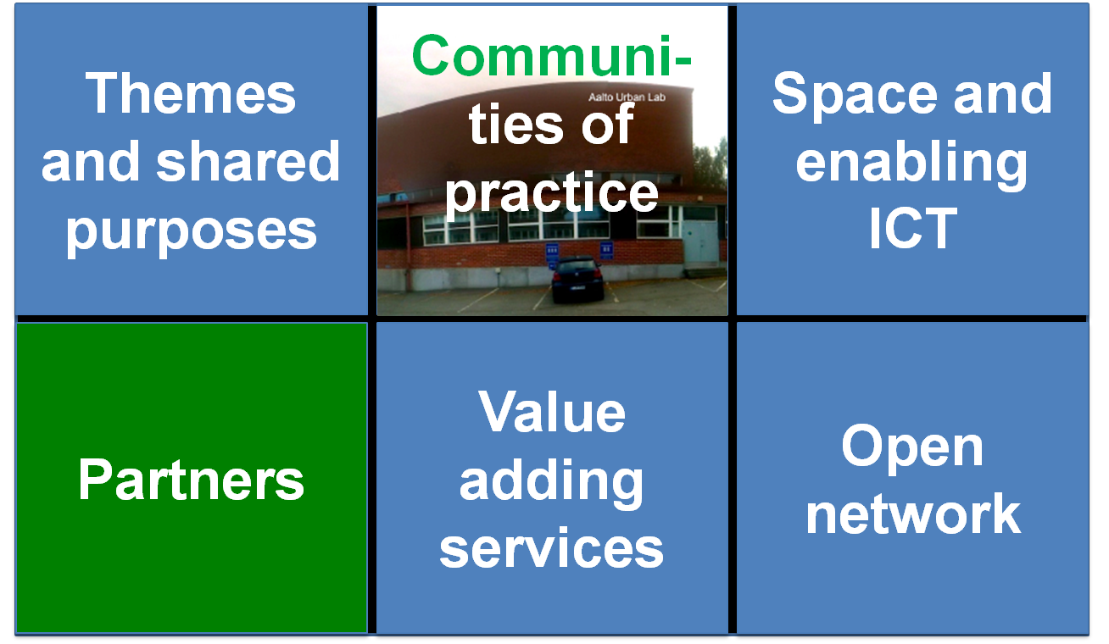
Urban Mill – Urbaanien innovaatioiden keskiö
Energizing Urban Ecosystems Research Program 2012-2015, WP Regional Innovation Ecosystem (RIE)
Task 7: T3 Ba & Flow, Aalto-yliopistokiinteistöt Oy & Järvelin Design Oy, Kari Mikkelä & Lars Miikki 16.1.2013

Slide 10
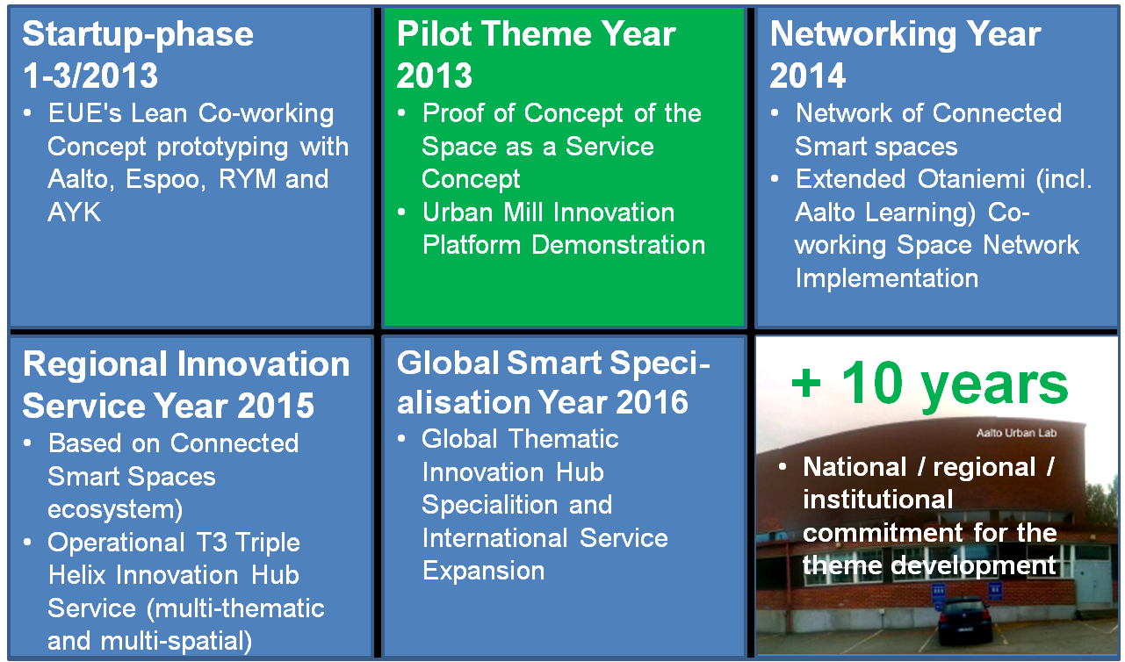
Urban Mill Road Map
Energizing Urban Ecosystems Research Program 2012-2015, WP Regional Innovation Ecosystem (RIE)
Task 7: T3 Ba & Flow, Aalto-yliopistokiinteistöt Oy & Järvelin Design Oy, Kari Mikkelä & Lars Miikki 16.1.2013

Slide 11
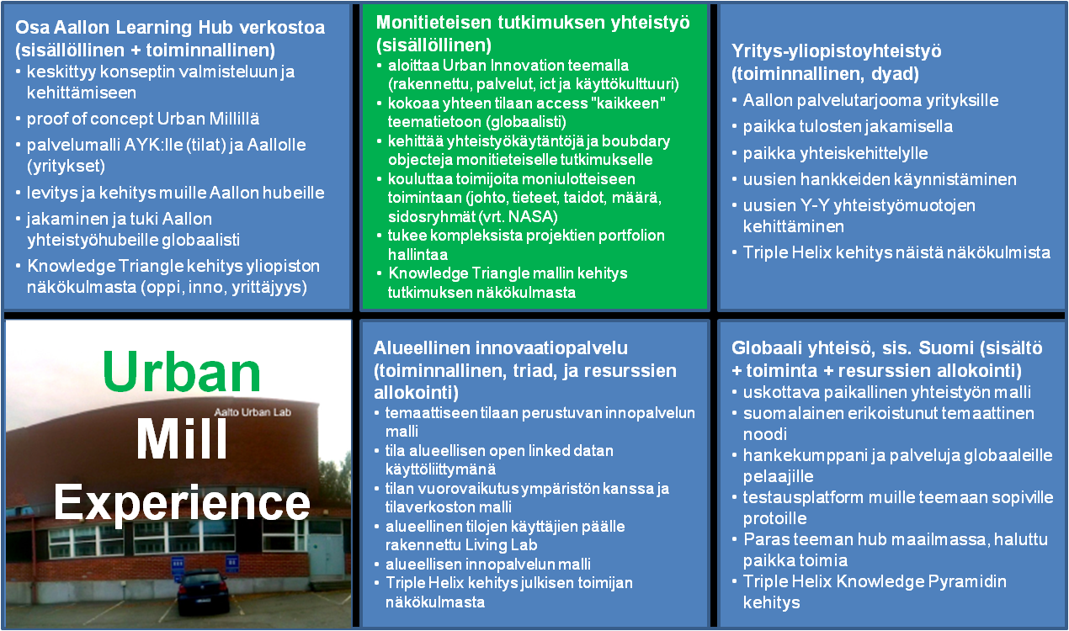
Urban Mill – bisnesmalliaihioita (draft)
Energizing Urban Ecosystems Research Program 2012-2015, WP Regional Innovation Ecosystem (RIE)
Task 7: T3 Ba & Flow, Aalto-yliopistokiinteistöt Oy & Järvelin Design Oy, Kari Mikkelä & Lars Miikki 16.1.2013

Slide 12
Use of the Urban Scene (big Hall)!?
Workshops & Co-working events (1-3 days)
Service Co-design Events (1-2 weeks)
Physical Prototypes & Demonstrations (+ lavastus)
Urban Innovation Boot Camps (3-8 days)
Connected Smart Space Testbed, Living Lab & T3 Showroom
Citizen participation events and forums
Cultural & Art events and exhibitions (one-time & background)
Co-learning & Training sessions
Energizing Urban Ecosystems Research Program 2012-2015, WP Regional Innovation Ecosystem (RIE)
Task 7: T3 Ba & Flow, Aalto-yliopistokiinteistöt Oy & Järvelin Design Oy, Kari Mikkelä & Lars Miikki 16.1.2013

Slide 13
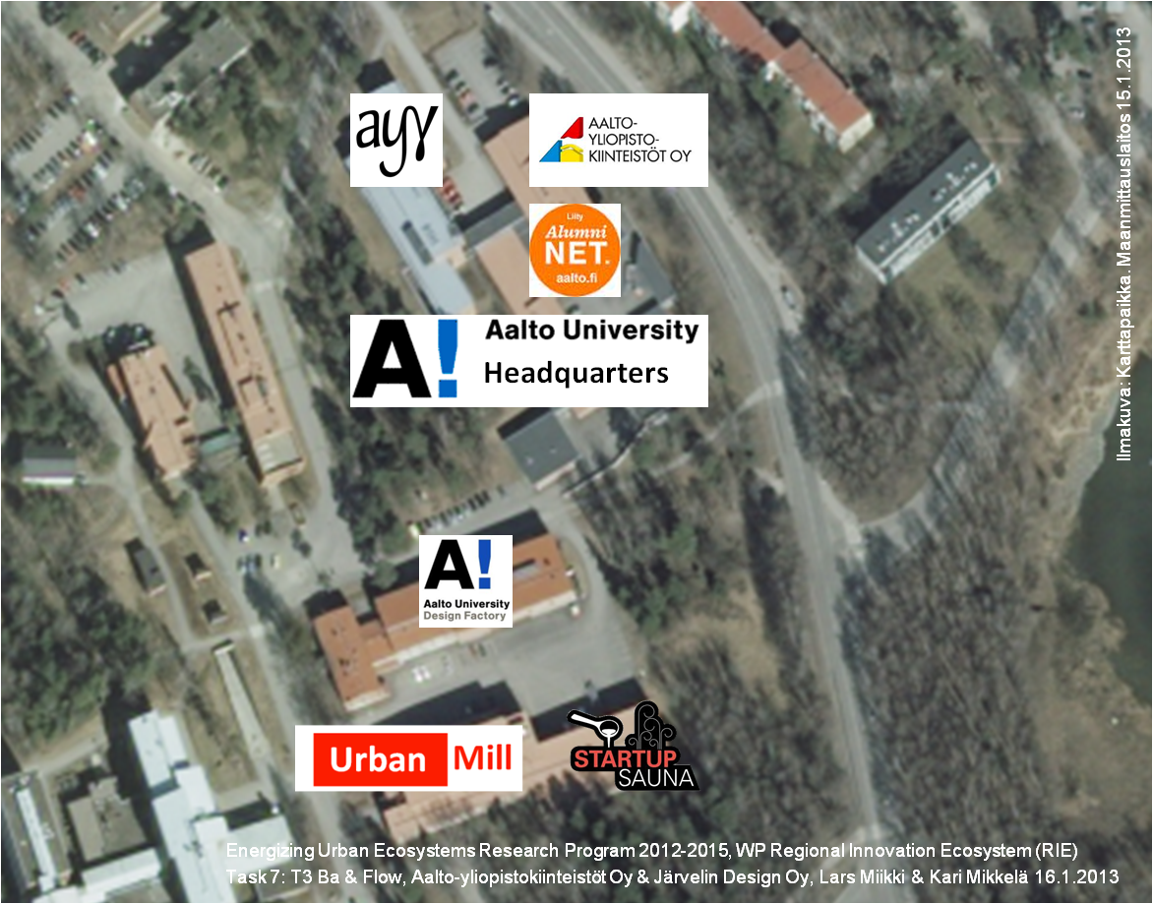




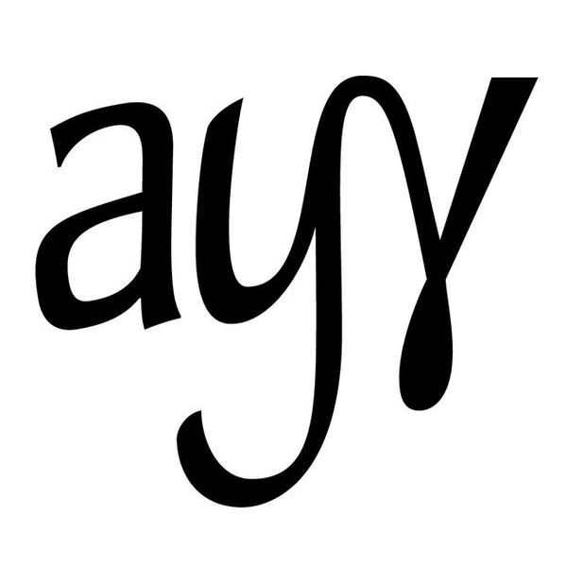



Emerging Innovation Garden!
Taiteiden talo
Headquarters

